Slide 1

Reactive Extensions

Slide 2
Reactive Extensions
Qu’est ce que c’est ?

Slide 3

Itérateur asynchrone

Slide 4
Itérateur asynchrone

Slide 5
Itérateur
Fournisseur
Client

Slide 6
Itérateur
Fournisseur
Client
next()

Slide 7
Itérateur
Fournisseur
Client
next()
return

Slide 8
Itérateur
Fournisseur
Client
next()
return
next()

Slide 9
Itérateur
Fournisseur
Client
next()
return
next()
return

Slide 10
Itérateur
Fournisseur
Client
next()
return
next()
return
next()

Slide 11
Itérateur
Fournisseur
Client
next()
return
next()
return
next()
return

Slide 12
Itérateur
synchrone
Fournisseur
Client
next()
return
blocage…
next()
blocage…
return
next()
return
blocage…

Slide 13
Itérateur
asynchrone
Fournisseur
Client

Slide 14
Itérateur
asynchrone
Fournisseur
Client
subscribe()

Slide 15
Itérateur
asynchrone
Fournisseur
Client
subscribe()
onNext()

Slide 16
Itérateur
asynchrone
Fournisseur
Client
subscribe()
onNext()
onNext()

Slide 17
Itérateur
asynchrone
Fournisseur
Client
subscribe()
onNext()
onNext()
onNext()

Slide 18
Itérateur
asynchrone
Fournisseur
Client
subscribe()
onNext()
blocage…
onNext()
blocage…
onNext()

Slide 19
Itérateur
asynchrone
Observable
Observer
subscribe()
onNext()
onNext()
onNext()

Slide 20

Iterator, Observer ?

Slide 21


Slide 22
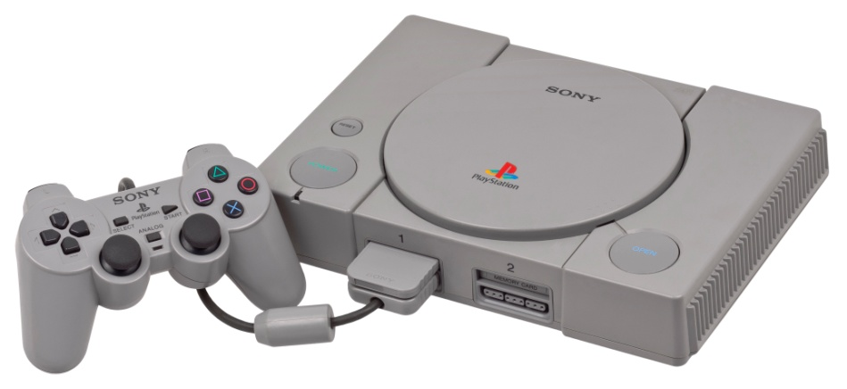
1994

Slide 23


Iterator
Fournisseur
Client
Observer

Slide 24
Iterator
PULL
Fournisseur
Client
PUSH
Observer

Slide 25
Iterator
Observer
T next()
onNext(T)
throws Exception()
onError(Exception)
!hasNext()
onCompleted()

Slide 26
TODO Inverser les couleurs ?
Un exemple ?

Slide 27
TODO Inverser les couleurs ?
List<String> names = {Bruce, Peter, Clark}
Observable.from(names).subscribe(
new Action1<String>() {
public void call(String s) {
System.out.println("Hello " + s + "!");
}
});
> Hello Bruce !
> Hello Peter !
> Hello Clark !

Slide 28
TODO Inverser les couleurs ?
List<String> names = {Bruce, Peter, Clark}
Observable.from(names).subscribe(
new Action1<String>() {
public void call(String s) {
System.out.println("Hello " + s + "!");
}
});
Créé un Observable
> Hello Bruce !
> Hello Peter !
> Hello Clark !

Slide 29
TODO Inverser les couleurs ?
List<String> names = {Bruce, Peter, Clark}
Observable.from(names).subscribe(
new Action1<String>() {
public void call(String s) {
System.out.println("Hello " + s + "!");
}
});
Ceci est un Observer
> Hello Bruce !
> Hello Peter !
> Hello Clark !

Slide 30
TODO Inverser les couleurs ?
List<String> names = {Bruce, Peter, Clark}
Observable.from(names).subscribe(
new Action1<String>() {
public void call(String s) {
System.out.println("Hello " + s + "!");
}
});
> Hello Bruce !
> Hello Peter !
> Hello Clark !

Slide 31
Names
List<String> names = {Bruce, Peter, Clark}
Observable.from(names).subscribe(
new Action1<String>() {
public void call(String s) {
System.out.println("Hello " + s + "!");
}
});
> Hello Bruce !
> Hello Peter !
> Hello Clark !

Slide 32
Names
Print()
List<String> names = {Bruce, Peter, Clark}
Observable.from(names).subscribe(
new Action1<String>() {
public void call(String s) {
System.out.println("Hello " + s + "!");
}
});
> Hello Bruce !
> Hello Peter !
> Hello Clark !

Slide 33
Names
Print()
List<String> names = {Bruce, Peter, Clark}
Observable.from(names).subscribe(
new Action1<String>() {
public void call(String s) {
System.out.println("Hello " + s + "!");
}
});
> Hello Bruce !
> Hello Peter !
> Hello Clark !

Slide 34
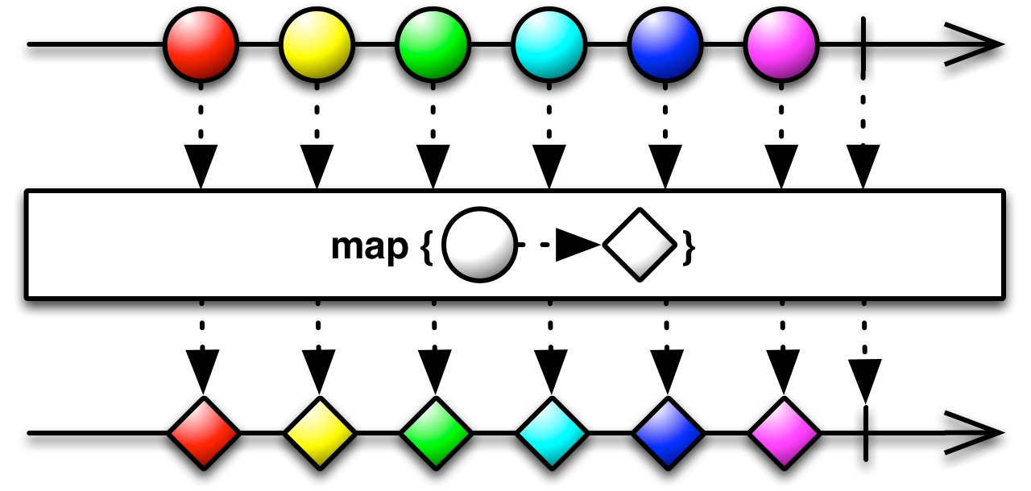
Map

Slide 35
Names
GetIdentity()
Print()
List<String> names = {Bruce, Peter, Clark}
Observable.from(names)
.map(
new Func1<String, String>(){
public String call(String name) {
return NSAService.getIdentity(name);
}
})
.subscribe(
(s) -> {System.out.println("Hello " + s + "!");}
);
> Hello Hulk !
> Hello Spiderman !
> Hello Superman !

Slide 36
Names
GetIdentity()
Print()
List<String> names = {Bruce, Peter, Clark}
Observable.from(names)
.map(
new Func1<String, String>(){
public String call(String name) {
return NSAService.getIdentity(name);
}
})
.subscribe(
(s) -> {System.out.println("Hello " + s + "!");}
);
lambda Java 8
> Hello Hulk !
> Hello Spiderman !
> Hello Superman !

Slide 37
Names
GetIdentity()
Print()
List<String> names = {Bruce, Peter, Clark}
Observable.from(names)
.map(
(name) -> {return NSAService.getIdentity(name);}
)
.subscribe(
(s) -> {System.out.println("Hello " + s + "!");}
);
lambda Java 8
> Hello Hulk !
> Hello Spiderman !
> Hello Superman !

Slide 38
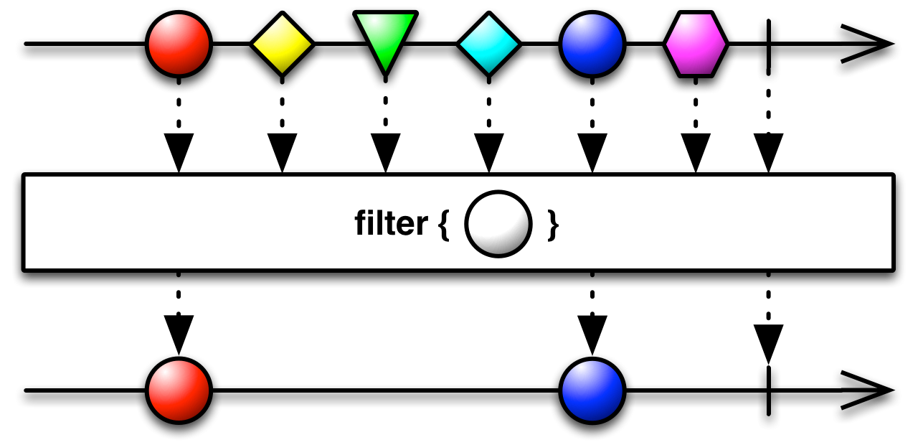
Filter

Slide 39
Names
GetIdentity()
isAnAvenger()
Print()
List<String> names = {Bruce, Peter, Clark}
Observable.from(names)
.map(
(name) -> {return NSAService.getIdentity(name);}
)
.filter(
(hero) -> {return Avengers.contains(hero);}
)
.subscribe(
(s) -> {System.out.println("Hello " + s + "!");}
);
> Hello Hulk !
> Hello Spiderman !

Slide 40
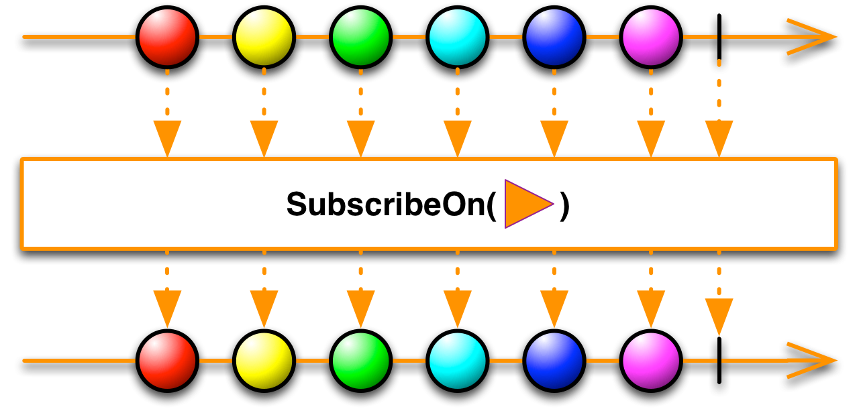
SubscribeOn

Slide 41
Names
GetIdentity()
isAnAvenger()
Print()
List<String> names = {Bruce, Peter, Clark}
Observable.from(names)
.subscribeOn(Schedulers.newThread())
.map(
(name) -> {return NSAService.getIdentity(name);}
)
.filter(
(hero) -> {return Avengers.contains(hero);}
)
.subscribe(
(s) -> {System.out.println("Hello " + s + "!");}
);
> Hello Spiderman !
> Hello Hulk !
> Hello Hulk !
> Hello Spiderman !

Slide 42
Names
GetIdentity()
isAnAvenger()
Print()
List<String> names = {Bruce, Peter, Clark}
Observable.from(names)
.subscribeOn(Schedulers.computation())
.map(
(name) -> {return NSAService.getIdentity(name);}
)
.filter(
(hero) -> {return Avengers.contains(hero);}
)
.subscribe(
(s) -> {System.out.println("Hello " + s + "!");}
);
> Hello Spiderman !
> Hello Hulk !
> Hello Hulk !
> Hello Spiderman !

Slide 43
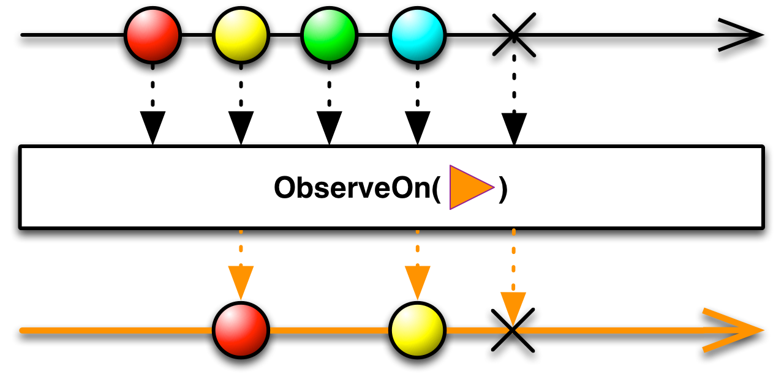
ObserveOn

Slide 44
Names
GetIdentity()
isAnAvenger()
Print()
List<String> names = {Bruce, Peter, Clark}
Observable.from(names)
.subscribeOn(Schedulers.computation())
.map(
(name) -> {return NSAService.getIdentity(name);}
)
.filter(
(hero) -> {return Avengers.contains(hero);}
)
.subscribe(
(s) -> {androidListView.getModel().addElement(s);}
);

Slide 45
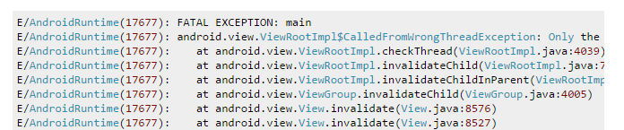
Names
GetIdentity()
isAnAvenger()
Print()
List<String> names = {Bruce, Peter, Clark}
Observable.from(names)
.subscribeOn(Schedulers.computation())
.map(
(name) -> {return NSAService.getIdentity(name);}
)
.filter(
(hero) -> {return Avengers.contains(hero);}
)
.subscribe(
(s) -> {androidListView.getModel().addElement(s);}
);

Slide 46
Names
GetIdentity()
isAnAvenger()
Print()
List<String> names = {Bruce, Peter, Clark}
Observable.from(names)
.subscribeOn(Schedulers.computation())
.map(
(name) -> {return NSAService.getIdentity(name);}
)
.filter(
(hero) -> {return Avengers.contains(hero);}
)
.observeOn(AndroidSchedulers.mainThread())
.subscribe(
(s) -> {androidListView.getModel().addElement(s);}
);

Slide 47
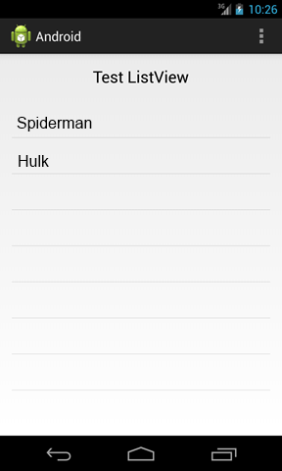
Names
GetIdentity()
isAnAvenger()
Print()
List<String> names = {Bruce, Peter, Clark}
Observable.from(names)
.subscribeOn(Schedulers.computation())
.map(
(name) -> {return NSAService.getIdentity(name);}
)
.filter(
(hero) -> {return Avengers.contains(hero);}
)
.observeOn(AndroidSchedulers.mainThread())
.subscribe(
(s) -> {androidListView.getModel().addElement(s);}
);

Slide 48
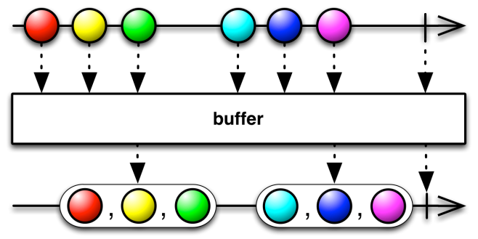
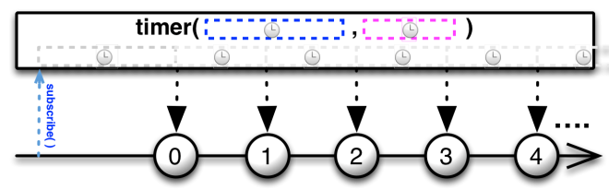
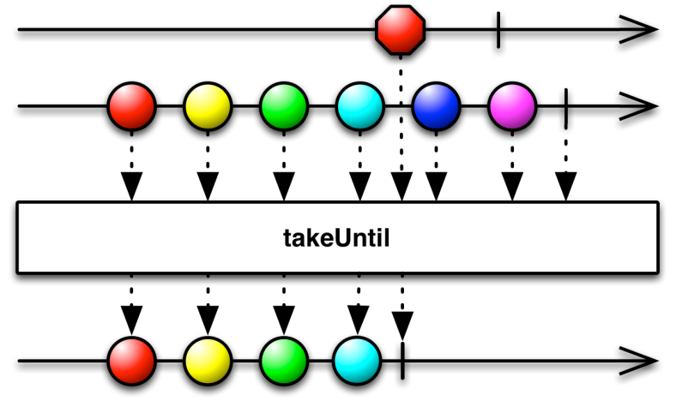
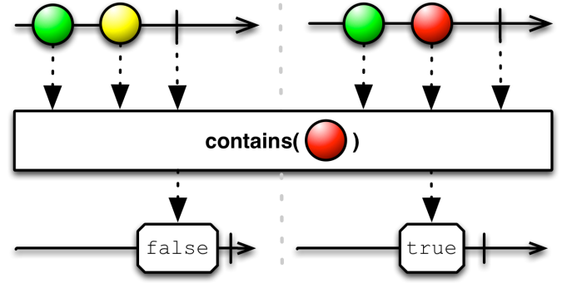
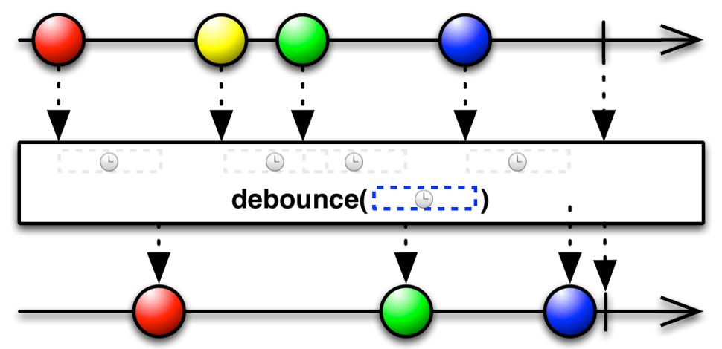
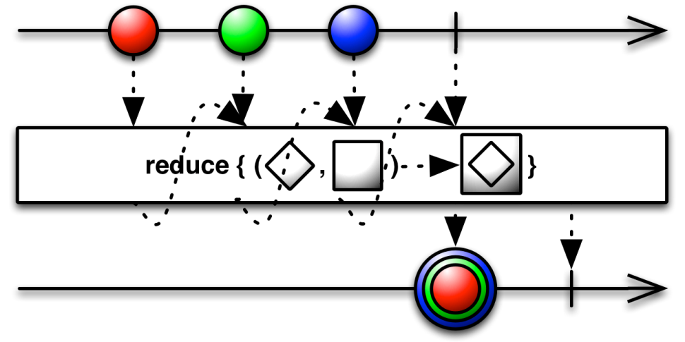
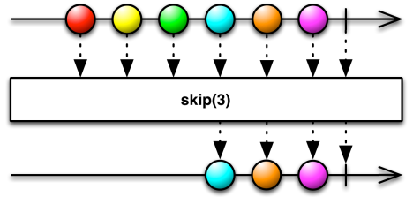

Slide 49


Slide 50

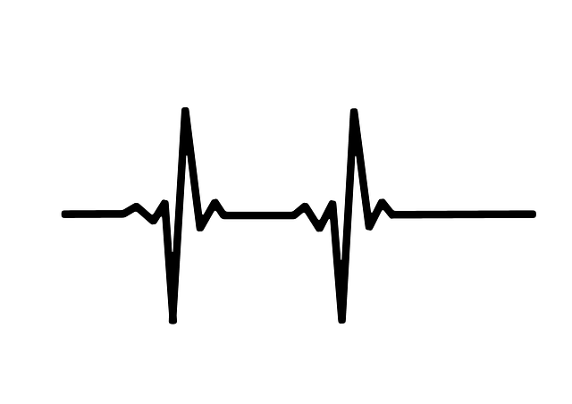



Sensor
Network Emitter
Network Receiver
GUI

Slide 51
DEMO
enfin !

Slide 52
Sensor

Slide 53
Observable sensor =
Observable.interval(1, TimeUnit.MILLISECONDS)
.map(
(time) -> {return device.getData(time);}
);

Slide 54
Observable sensor =
Observable.interval(1, TimeUnit.MILLISECONDS)
.map(
(time) -> {return device.getData(time);}
);

Slide 55
Observable sensor =
Observable.interval(1, TimeUnit.MILLISECONDS)
.map(
(time) -> {return device.getData(time);}
);

Slide 56
Observable sensor =
Observable.interval(1, TimeUnit.MILLISECONDS)
.map(
(time) -> {return device.getData(time);}
);

Slide 57
Observable sensor =
Observable.interval(1, TimeUnit.MILLISECONDS)
.map(
(time) -> {return device.getData(time);}
);
un peu trop rapide…

Slide 58
Observable sensor =
Observable.interval(1, TimeUnit.MILLISECONDS)
.map(
(time) -> {return device.getData(time);}
)
.throttleFirst(50, TimeUnit.MILLISECONDS);

Slide 59
Sensor

Slide 60
Network Emitter

Slide 61
ZMQ.Socket publisher = context.socket(ZMQ.PUB);
publisher.bind("tcp://*:5556");
sensor.forEach(
(value) -> {publisher.send(data, 0);}
)
.subscribe();

Slide 62

ZMQ.Socket publisher = context.socket(ZMQ.PUB);
publisher.bind("tcp://*:5556");
sensor.forEach(
(value) -> {publisher.send(data, 0);}
)
.subscribe();

Slide 63
ZMQ.Socket publisher = context.socket(ZMQ.PUB);
publisher.bind("tcp://*:5556");
sensor.forEach(
(value) -> {publisher.send(data, 0);}
)
.subscribe();

Slide 64
ZMQ.Socket publisher = context.socket(ZMQ.PUB);
publisher.bind("tcp://*:5556");
sensor.forEach(
(value) -> {publisher.send(data, 0);}
)
.subscribe();

Slide 65
ZMQ.Socket publisher = context.socket(ZMQ.PUB);
publisher.bind("tcp://*:5556");
sensor.forEach(
(value) -> {publisher.send(data, 0);}
)
.subscribe();

Slide 66
Network Emitter

Slide 67
Network Receiver

Slide 68
ZMQ.Socket socket = context.socket(ZMQ.SUB);
socket.subscribe(new byte[0]);
socket.connect("tcp://localhost:5556");
Observable receiver = ZeroMQObservables.from(socket)

Slide 69
ZMQ.Socket socket = context.socket(ZMQ.SUB);
socket.subscribe(new byte[0]);
socket.connect("tcp://localhost:5556");
Observable receiver = ZeroMQObservables.from(socket)

Slide 70
ZMQ.Socket socket = context.socket(ZMQ.SUB);
socket.subscribe(new byte[0]);
socket.connect("tcp://localhost:5556");
Observable receiver = ZeroMQObservables.from(socket)

Slide 71
ZMQ.Socket socket = context.socket(ZMQ.SUB);
socket.subscribe(new byte[0]);
socket.connect("tcp://localhost:5556");
Observable receiver = ZeroMQObservables.from(socket)
Fonction perso (12 loc)

Slide 72
Network Receiver

Slide 73
GUI

Slide 74
XYDataset dataset =
new DynamicTimeSeriesCollection(…)
JFreeChart chart =
ChartFactory.createTimeSeriesChart(…, dataset, …);
receiver.
.observeOn(SwingScheduler.getInstance())
.forEach(
(data) -> {dataset.appendData(array);}
)
.subscribe();

Slide 75

XYDataset dataset =
new DynamicTimeSeriesCollection(…)
JFreeChart chart =
ChartFactory.createTimeSeriesChart(…, dataset, …);
receiver.
.observeOn(SwingScheduler.getInstance())
.forEach(
(data) -> {dataset.appendData(array);}
)
.subscribe();

Slide 76
XYDataset dataset =
new DynamicTimeSeriesCollection(…)
JFreeChart chart =
ChartFactory.createTimeSeriesChart(…, dataset, …);
receiver.
.observeOn(SwingScheduler.getInstance())
.forEach(
(data) -> {dataset.appendData(array);}
)
.subscribe();

Slide 77
XYDataset dataset =
new DynamicTimeSeriesCollection(…)
JFreeChart chart =
ChartFactory.createTimeSeriesChart(…, dataset, …);
receiver.
.observeOn(SwingScheduler.getInstance())
.forEach(
(data) -> {dataset.appendData(array);}
)
.subscribe();

Slide 78
XYDataset dataset =
new DynamicTimeSeriesCollection(…)
JFreeChart chart =
ChartFactory.createTimeSeriesChart(…, dataset, …);
receiver.
.observeOn(SwingScheduler.getInstance())
.forEach(
(data) -> {dataset.appendData(array);}
)
.subscribe();

Slide 79
TODO : Transition pour introduire HTML5

Slide 80
Sensor
Network Emitter
Network Receiver
GUI

Slide 81


Sensor
Network Emitter
Network Receiver
GUI

Slide 82
DEMO

Slide 83
Network Receiver

Slide 84
function fromWebSocket(address) {
var ws = new WebSocket(address);
// Handle the data
var osbervable = Rx.Observable.create (function (obs) {
// Handle messages
ws.onmessage = obs.onNext.bind(obs);
ws.onerror = obs.onError.bind(obs);
ws.onclose = obs.onCompleted.bind(obs);
// Return way to unsubscribe
return ws.close.bind(ws);
});
return osbervable;
}

Slide 85
function fromWebSocket(address) {
var ws = new WebSocket(address);
// Handle the data
var osbervable = Rx.Observable.create (function (obs) {
// Handle messages
ws.onmessage = obs.onNext.bind(obs);
ws.onerror = obs.onError.bind(obs);
ws.onclose = obs.onCompleted.bind(obs);
// Return way to unsubscribe
return ws.close.bind(ws);
});
return osbervable;
}

Slide 86
function fromWebSocket(address) {
var ws = new WebSocket(address);
// Handle the data
var osbervable = Rx.Observable.create (function (obs) {
// Handle messages
ws.onmessage = obs.onNext.bind(obs);
ws.onerror = obs.onError.bind(obs);
ws.onclose = obs.onCompleted.bind(obs);
// Return way to unsubscribe
return ws.close.bind(ws);
});
return osbervable;
}

Slide 87
function fromWebSocket(address) {
var ws = new WebSocket(address);
// Handle the data
var osbervable = Rx.Observable.create (function (obs) {
// Handle messages
ws.onmessage = obs.onNext.bind(obs);
ws.onerror = obs.onError.bind(obs);
ws.onclose = obs.onCompleted.bind(obs);
// Return way to unsubscribe
return ws.close.bind(ws);
});
return osbervable;
}

Slide 88
function fromWebSocket(address) {
var ws = new WebSocket(address);
// Handle the data
var osbervable = Rx.Observable.create (function (obs) {
// Handle messages
ws.onmessage = obs.onNext.bind(obs);
ws.onerror = obs.onError.bind(obs);
ws.onclose = obs.onCompleted.bind(obs);
// Return way to unsubscribe
return ws.close.bind(ws);
});
return osbervable;
}

Slide 89
function fromWebSocket(address) {
var ws = new WebSocket(address);
// Handle the data
var osbervable = Rx.Observable.create (function (obs) {
// Handle messages
ws.onmessage = obs.onNext.bind(obs);
ws.onerror = obs.onError.bind(obs);
ws.onclose = obs.onCompleted.bind(obs);
// Return way to unsubscribe
return ws.close.bind(ws);
});
return osbervable;
}

Slide 90
Network Receiver

Slide 91
GUI

Slide 92
fromWebSocket('ws://localhost:8887/')
.throttleFirst(150)
.subscribe(
function (evt) {
var series = chart.series[0];
var x = (new Date()).getTime();
var y = parseFloat(evt.data);
series.addPoint([x,y], true, true);
});

Slide 93
fromWebSocket('ws://localhost:8887/')
.throttleFirst(150)
.subscribe(
function (evt) {
var series = chart.series[0];
var x = (new Date()).getTime();
var y = parseFloat(evt.data);
series.addPoint([x,y], true, true);
});

Slide 94
fromWebSocket('ws://localhost:8887/')
.throttleFirst(150)
.subscribe(
function (evt) {
var series = chart.series[0];
var x = (new Date()).getTime();
var y = parseFloat(evt.data);
series.addPoint([x,y], true, true);
});

Slide 95
fromWebSocket('ws://localhost:8887/')
.throttleFirst(150)
.subscribe(
function (evt) {
var series = chart.series[0];
var x = (new Date()).getTime();
var y = parseFloat(evt.data);
series.addPoint([x,y], true, true);
});

Slide 96
fromWebSocket('ws://localhost:8887/')
.throttleFirst(150)
.subscribe(
function (evt) {
var series = chart.series[0];
var x = (new Date()).getTime();
var y = parseFloat(evt.data);
series.addPoint([x,y], true, true);
});

Slide 97
TODO : Faire transition avec listes langages et plateforme

Slide 98

C# .NET

Slide 99
Java
C# .NET

Slide 100
JavaScript
Java
C# .NET

Slide 101
JavaScript
Java
C# .NET
Python

Slide 102
JavaScript
Java
C# .NET
Python
C++

Slide 103
JavaScript
Java
C# .NET
Ruby
Python
C++

Slide 104
Scala
JavaScript
Java
C# .NET
Ruby
Python
C++

Slide 105
Scala
JavaScript
Groovy
Java
C# .NET
Ruby
Python
C++

Slide 106
Scala
Clojure
JavaScript
Groovy
Java
C# .NET
Ruby
Python
C++

Slide 107
Scala
Clojure
JavaScript
Groovy
Java
JRuby
C# .NET
Ruby
Python
C++

Slide 108
Scala
Clojure
JavaScript
Groovy
Kotlin
Java
JRuby
C# .NET
Ruby
Python
C++

Slide 109
Scala
Clojure
JavaScript
Groovy
Kotlin
Java
JRuby
C# .NET
Ruby
Unity3D
Python
C++

Slide 110
Scala
Clojure
JavaScript
Groovy
Kotlin
Java
JRuby
Android
C# .NET
Ruby
Unity3D
Python
C++

Slide 111
Scala
Clojure
JavaScript
Groovy
Kotlin
Java
JRuby
Android
C# .NET
Ruby
Netty
Unity3D
Python
C++

Slide 112
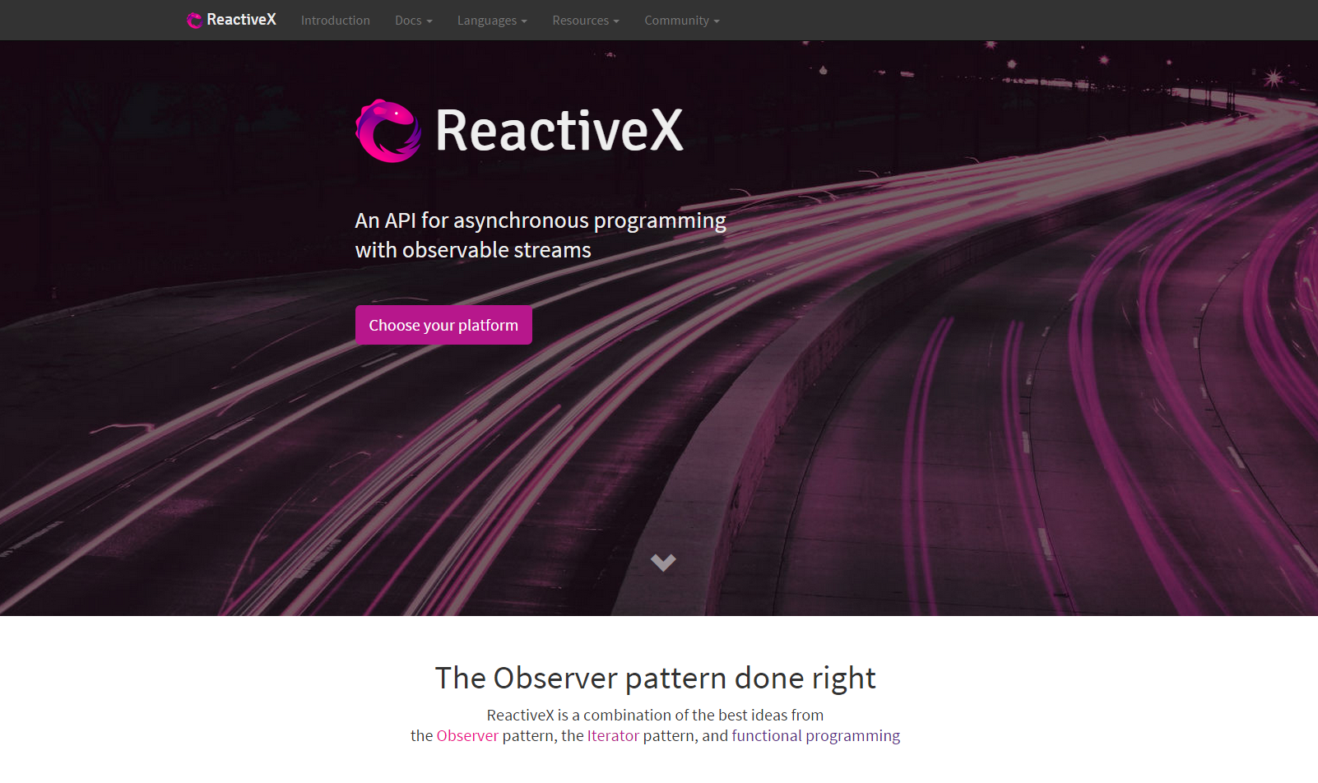

Slide 113
TODO : Capture des sites

Slide 115



2009
Reactive Extensions pour .NET 3.5
2012
Reactive Extensions pour JavaScript
2013
Reactive Extensions pour Java
2013, 2014
Reactive Extensions pour C++, Ruby, Python
nouveau logo

Slide 119
-------------------------------------------------------------------------------------------------------------------

Slide 120
Reactive Extensions

Slide 121
Reactive Extensions

Slide 122
Functionnal Reactive Programming
Retour aux sources
var userChoices =
user.movies.foreach(
S’exécute sur le thread UI

Slide 124


Slide 125


Slide 127


Slide 129


